Slide 1

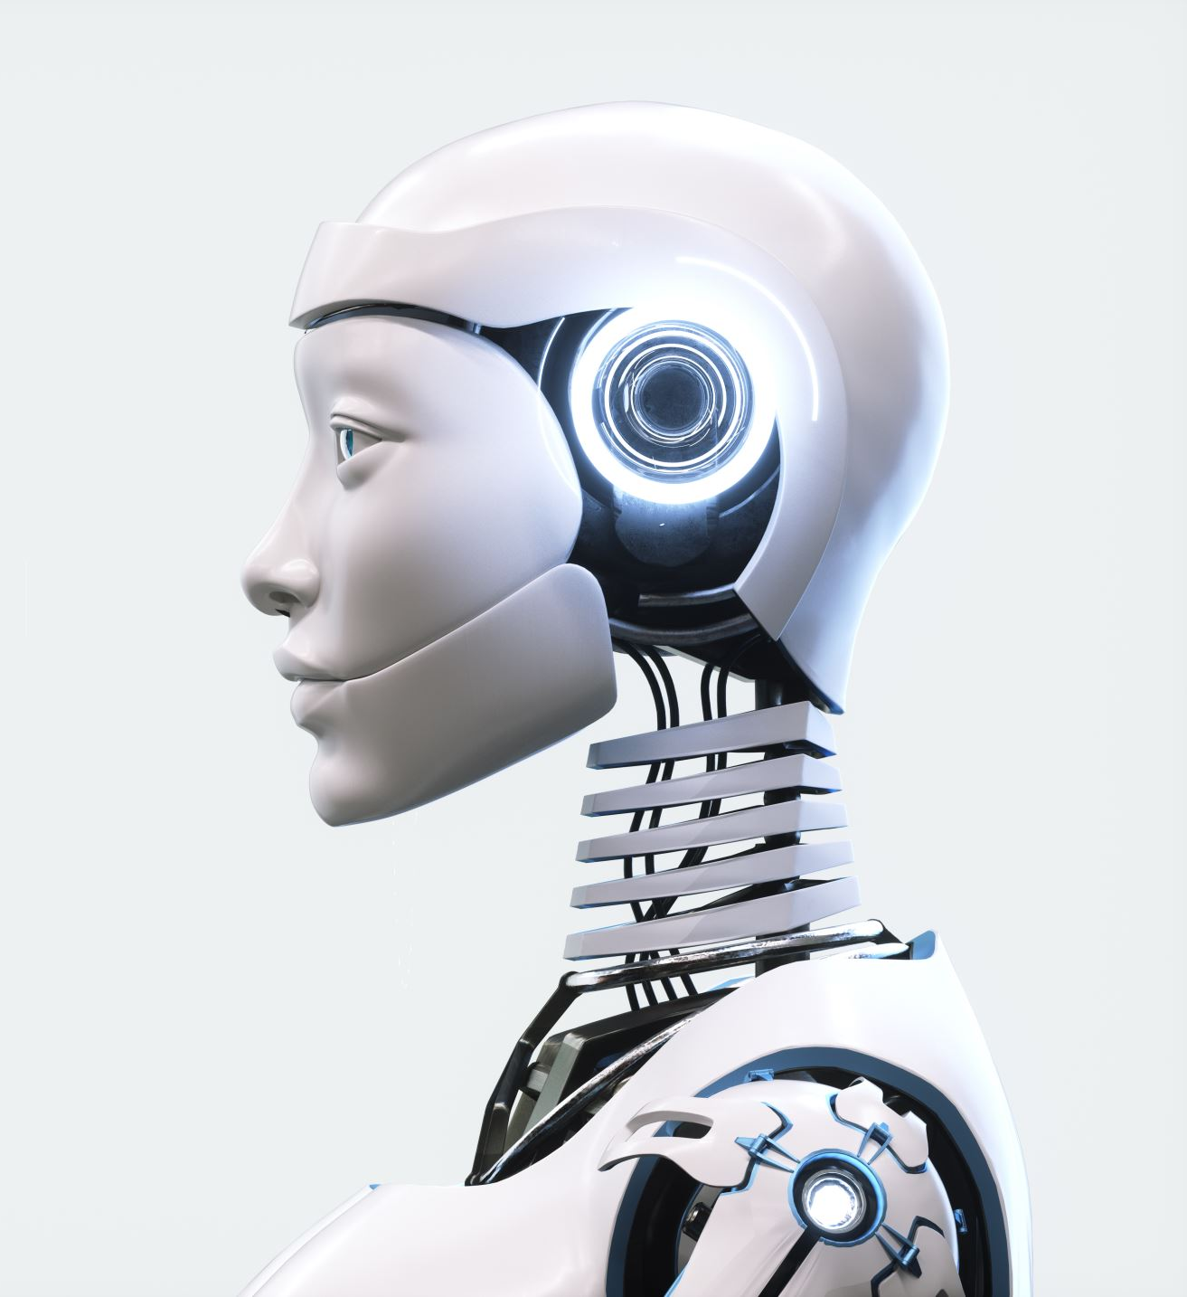

Human Body Recognition
Using a new
Deep Learning Approach

Slide 2


Submitted To:
Prof. Xingquan Zhu
EECS Department
Submitted By:
Name: Neelima Rajawat
Masters in Artificial Intelligence

Slide 3

Index
What is Computer Vision..?
Components of Artificial Intelligence
How Computer Vision Works
Human Body Recognition
How to choose a model
Human Activity Recognition
How does HAR work?
Human Body Posture Recognition
Key Steps for Human Body Posture Recognition
Application of Human Body Posture
Implementation
HOG Descriptor
HAAR Cascade
HOG VS HAAR
Used Tools and Techs
Algorithm
Implementation
Conclusion
Reference

Slide 4

What is Computer vision..?
Computer vision is one field of AI that enables devices to drive meaningful information from digital data, i.e., image/video/ and different visual inputs.
Computer vision uses AI/ML for training models to recognize specific patterns and store the data in their AI memory.
Computer Vision can even take actions and make recommendations based on that information.
Using digital images from cameras and videos and deep learning models, machines can accurately identify and classify objects – and then react to what they ”see.”

Slide 5
Components of Artificial Intelligence
Different components of AI :-
Artificial Intelligence
M
Computer Vision
Machine Learning
Deep Learning

Slide 6

HOW computer Vision Works?
Computer vision works in three basic steps:
Acquiring an image: Images, even large sets, can be achieved in real-time through video, photos, or 3D technology for analysis.
Processing the image: Deep learning models automate much of this process, but the models are often trained by being fed thousands of labeled or pre-identified photos.
Understanding the image: The final step is the interpretative step, where an object is identified or classified.

Slide 7
Human Body Recognition
Human Body recognition involves the detection of human bodies.
Human Body Detection is the process of detecting humans, their faces, expressions, postures, movements, or just their presence.
Where, we focus
Human Activity Recognition
Human body Posture recognition

Slide 8
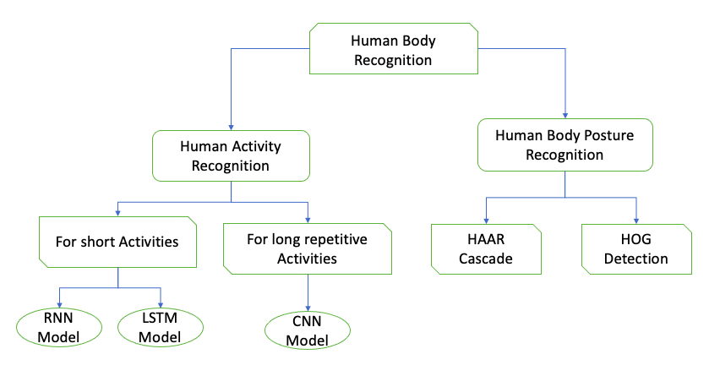
Human Body Recognition

Slide 9
How to choose a model
When choosing a model, there are two main metrics: accuracy and inference time.
Accuracy: it is measured through mean average precision (mAP), which combines two requirements for the mode: finding all the objects in an image and checking if the class assigned is correct it is measured through a percentage (the higher the percentage, the more accurate the model).
Inference time: It is how long it takes to execute the algorithm, and it's typically measured in frames per second (FPS) or milliseconds (ms). The lower the time it takes, the better and the most useful it is for real-time applications. This metric is key if you are looking to use these models in products.

Slide 10
Human Activity Recognition
Human Activity Recognition (HAR) is an exciting research area in computer vision and human-computer interaction.
Automatic detection of human physical activity has become crucial in pervasive computing, interpersonal communication, and human behavior analysis.
HAR benefits human safety and general well-being through Health monitoring.
HAR-based solutions save energy and personal comfort by detecting when a person enters or leaves a room and adjusting the lighting or temperature.

Slide 11
HOW HAR works
Data Collection
Data pre-processing
Filtering
Feature Extraction
Feature Selection
Segmentation
Normalization
Model Selection
Decision Trees
Random Forest
Support vector Machine
Hidden Markov Model
Convolution Neural Network
Recurrent Neural Network
Model Deployment
External Sensing Deployment
On-body sensing deployment

Slide 12
Human Body Posture Recognition
Human body posture recognition can be done using computer vision.
This can be done using algorithms and techniques to analyze and interpret the body positions and orientations of human images or video frames.
This is helpful in fields, such as healthcare, sports analysis, security, and human-computer interaction.

Slide 13
Key Steps for HUMAN body posture…
1. Image Acquisition: Get image/video of humans
1
2. Human Detection: Use methods for detecting and locating human bodies. Ex: HAAR CASCADE
HOG DETECTION
2
3. Key Point Detection: detect critical points such as pose estimation or joint detections.
3
4. Pose Estimation: Estimate the body posture by connecting all the key points
4
5. Posture Recognition: analyze the estimated pose to recognize the specific posture or gesture.
5

Slide 14
Application of Human body posture
We can implement human body posture recognition method in various fields:
Healthcare: For monitoring patient movements and physiotherapy exercises.
Sports Analysis: For analyzing athletes' movements and techniques.
Security: For identifying suspicious behaviors or anomalies.
Human-Computer Interaction: For enabling gesture-based interfaces.

Slide 15
implemettion
Worked on the implementation of human body posture detection based on inclination.
01
This has been done using HAAR Cascade & HOG Detection models,
02
Which is implemented using OpenCV in python
03
Used cv2 packages for importing all the packages
04

Slide 16
1. Histogram of oriented Gradients (HOG)
HOG is a feature descriptor in computer vision and image processing for human body detection.
HOG extracts features into the vector and feeds it into a classification algorithm like a support vector machine(SVM).
In the HOG feature descriptor, the distribution(histograms) of directions of gradients(oriented gradients) are used as features.
When using the HOG descriptor for image similarity, one approach is to directly compare the histograms of two images using a distance metric such as the Euclidean distance or cosine similarity.
However, this approach can be sensitive to changes in lighting, contrast, and other factors that affect the overall intensity of the image.

Slide 17
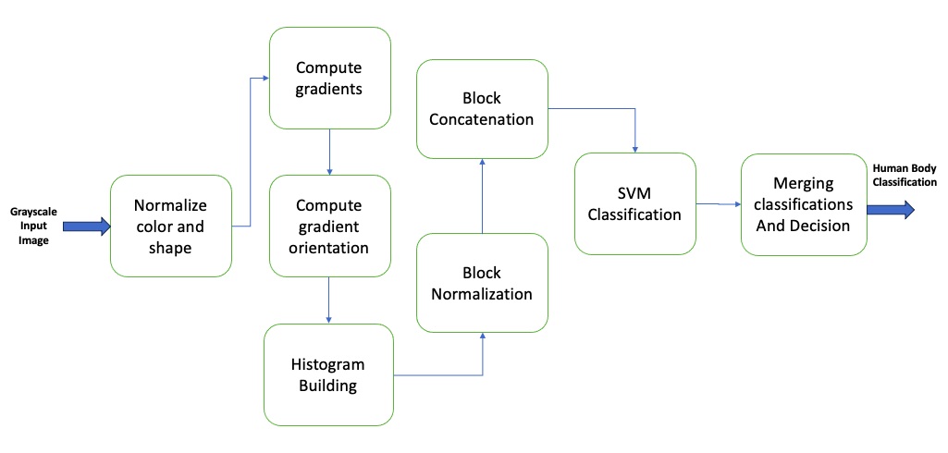
1. Histogram of oriented Gradients (HOG)

Slide 18
2. HAAR Cascade
HAAR classifier used in the first real-time face detection algorithm can be discussed in four stages:
Calculating HAAR Features
Creating Integral Images
Using Adaboost
Implementing Cascade Classifiers
Features are as (a) Edge features, (b)Line features, (c) Four rectangle Features.

Slide 19
HOG vs HAAR
Feature | HOG Descriptor | HAAR Cascade
Definition | Captures gradient patterns for object detection. | Uses Haar-like features for object detection.
Complexity | Computationally less expensive. | Can be computationally expensive, especially during training.
Scale Invariance | Less invariant; often requires multi-scale approaches. | Inherently incorporates scale invariance.
Rotation Invariance | Not inherently rotation invariant. | Not inherently rotation invariant.
Training | Involves adjusting feature weights during training. | It uses the Viola-Jones algorithm to select and weigh features.
Application Areas | Used in human and pedestrian detection. | Commonly used for face and eye detection.

Slide 20

Used Tech and TOOls
For input, used two methods:
Live Camera
Dataset(where I chose almost 1200 different postures)
So, A system with a working camera is required if we want to use the live camera input method.
I used PyCharm and from that Jupyter Notebook using command
Python –m notebook

Slide 21

Used tech and TOOLS
OpenCV
OpenCV is a library of programming functions mainly for real-time computer vision.
Python
Python is the programming language in which code is written.
Here, used Python version 3.11.2
Jupyter Notebook
The Jupyter Notebook is a potent tool for interactively developing and presenting data science projects.

Slide 22
Algorithm
Step1: Data Collection
The first step is to collect the dataset in the format of images or videos of humans/ Human bodies.
Step2: Data Processing
Here, we are working on two things:
Resizing dataset for model input
Normalize the pixel values in common ranges for all the images.
Step3: Select Model for Recognition
Here, we have given two options for human body recognition, which are as
HOG Detector
HAAR Cascade
Step4: Choosing Input Method
In this step, we have two options:
Option -1: Live Camera
Option -2: Input Dataset

Slide 23
Algorithm
Step5: Human Pose Estimation
In this step, we train the pose estimate model for the input dataset. This model is used to predict the human body posture based on the inclination:
Step6: Post-Processing
Step7: Visualization of Detected Bodies
Step8: Validation of Results
Posture = [ "Bent Over", "Almost Lied Down", "Standing Straight", "Not Straight" ]
In this step, we refine the pose estimation results by filtering out based on confusion matrix values false positive, false negative, true negative, and true negative. Focusing on noisy key points by looking closely at false positive values.
Visualize the detected human body postures after recognizing the original image or video.
In this step, we recognize the result’s accuracy using an appropriate matrix, such as the union of human body recognition and test accuracy for pose estimation.

Slide 24
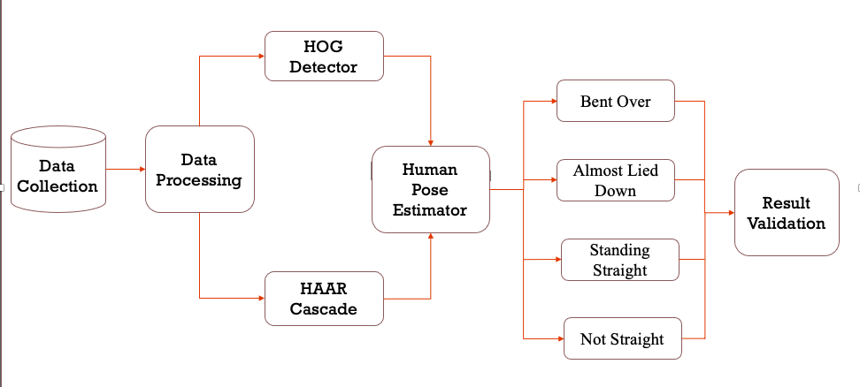
Implementation

Slide 25
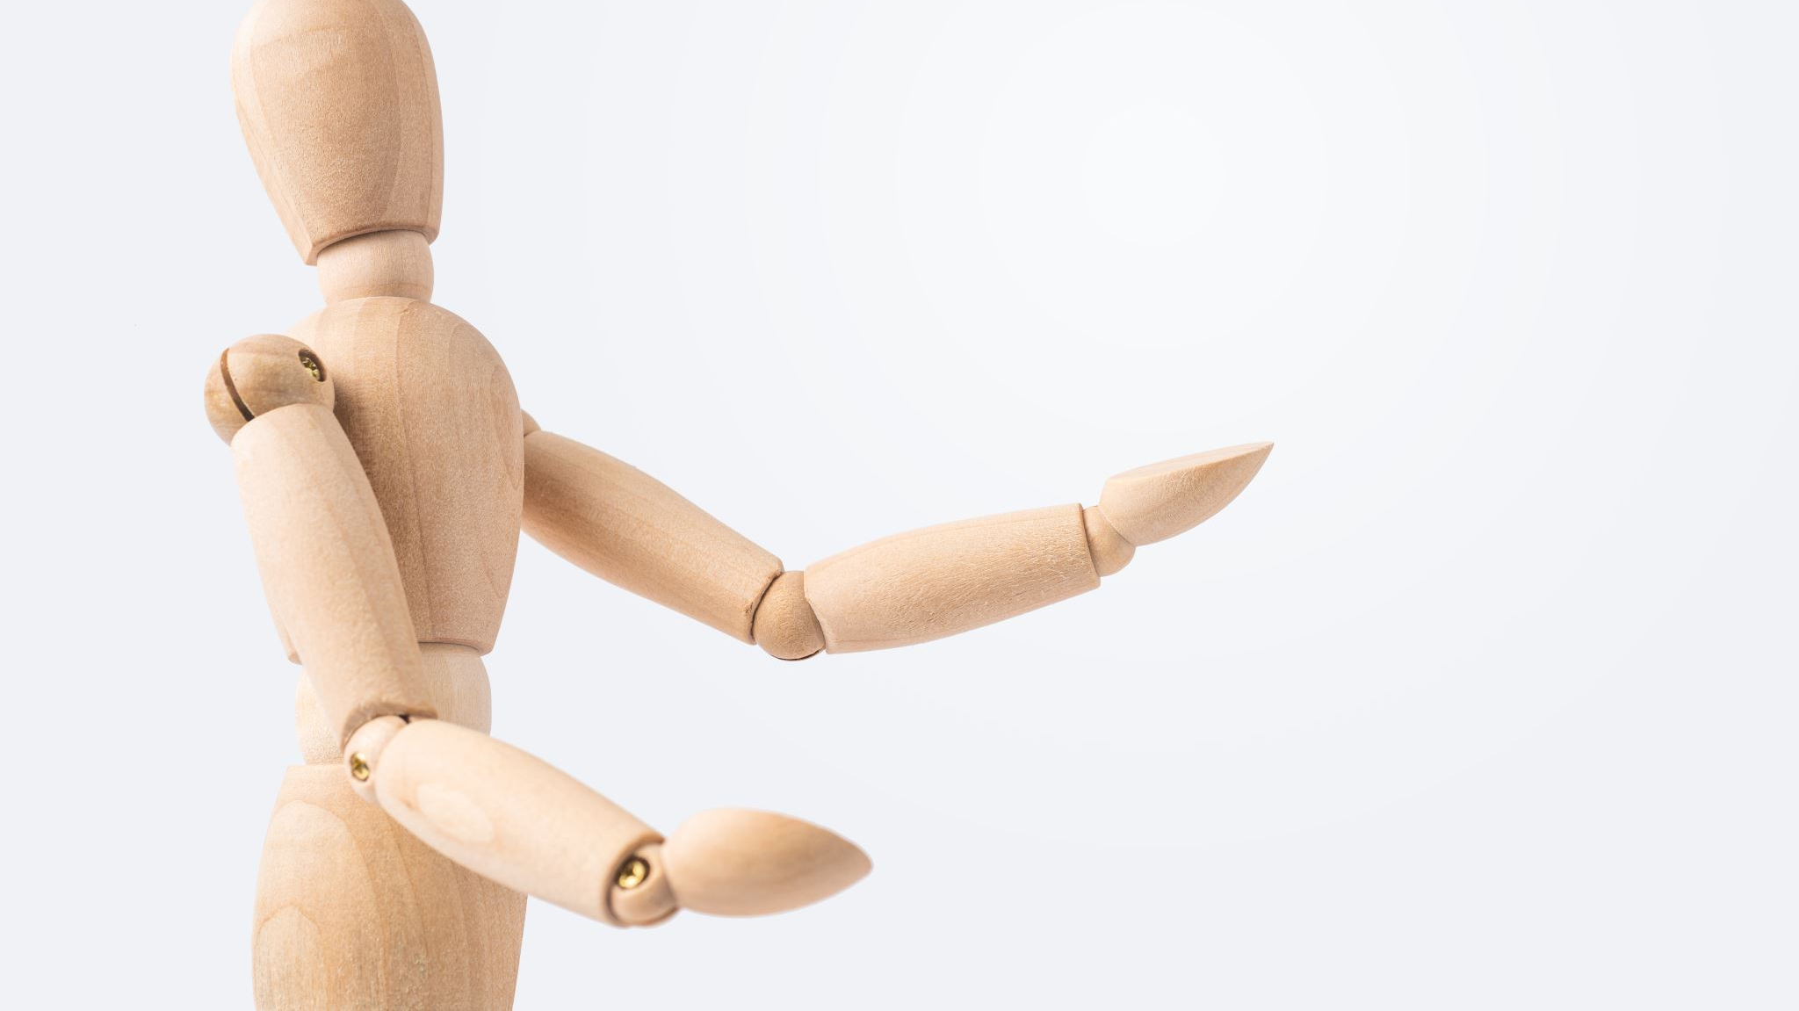
Conclusion
By working on this project for human body recognition based on inclination, we are defining human body position.
So, I worked with almost 1200 poses and tried to find their exact inclination based on the angle.
This implementation can help in proper standing or sitting or determining the exact human body posture.
In many places, it can help to predict and predefine the postures and suggest a better way of specifically showing accurately.
This can be a great application in different fields, such as sports, medicine, and healthcare.

Slide 26
rEFERENCE
https://www.v7labs.com/blog/human-activity-recognition
https://pyimagesearch.com/2019/11/25/human-activity-recognition-with-opencv-and-deep-learning/
https://blog.tensorflow.org/2022/01/body-segmentation.html
https://blog.xmartlabs.com/blog/computer-vision-techniques-for-body-detection/
Dargazany, A. R. (2019). Human Body Parts Tracking: Applications to Activity Recognition. arXiv preprint arXiv:1907.05281.
Mehendale, N. (2020). Facial emotion recognition using convolutional neural networks (FERC). SN Applied Sciences, 2(3), 446.
Kong, Y., & Fu, Y. (2022). Human action recognition and prediction: A survey. International Journal of Computer Vision, 130(5), 1366-1401.

Slide 27

Thanks

